Slide 1

ETS division Strategic Plan (2025-27)
Brett Mello – Chief Information Officer

Slide 2
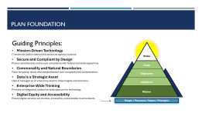
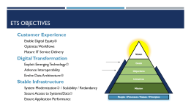
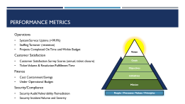
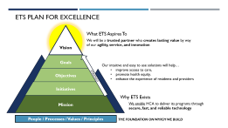
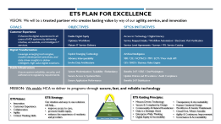
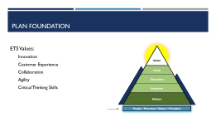
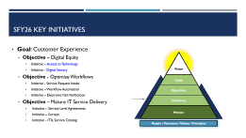

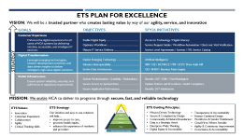
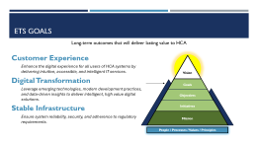
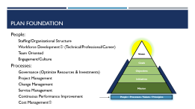
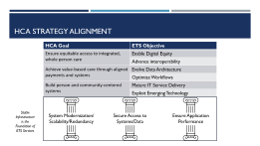
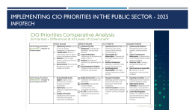

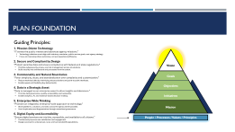
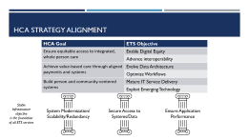
Table of contents
Plan for Excellence
People/Process
Values
Guiding Principles
Goals
Objectives
Strategic Alignment
Key Initiatives
Metrics
Plan Summary
References

Slide 3
ETS Plan for excellence
Vision
  What ETS Aspires To
  We will be a trusted partner who creates lasting value by way of our agility, service, and innovation
Goals
Our intuitive and easy to use solutions will help…
  improve access to care,
  promote health equity,
  enhance the experience of residents and providers
Objectives
STRATEGY
Initiatives
Mission
  Why ETS Exists
    We enable HCA to deliver its programs through secure, fast, and reliable technology
People / Processes / Values / Principles
  THE FOUNDATION ON WHICH WE BUILD

Slide 4
Plan foundation
The base on which we build

Slide 5
Plan foundation
  People:
    Staffing/Organizational Structure
    Workforce Development③ (Technical/Professional/Career)
    Team Oriented
    Engagement/Culture
  Processes:
    Governance (Optimize Resources & Investments)
    Project Management
    Change Management
    Service Management
    Continuous Performance Improvement
    Cost Management⑤
Vision
Goals
Objectives
Initiatives
Mission
People / Processes / Values / Principles

Slide 6
Plan foundation
ETS Values:
  Innovation
  Customer Experience
  Collaboration
  Agility
  Critical Thinking Skills
Vision
Goals
Objectives
Initiatives
Mission
People / Processes / Values / Principles
Notes:
Culture

Slide 7
Plan foundation
Vision
Guiding Principles:
Mission-Driven Technology
IT serves the public interest and advances agency missions.
Secure and Compliant by Design
Protect sensitive data and ensure compliance with federal and state regulations.
Commonality and Natural Boundaries
Favor simplicity, reuse, and standardization over complexity and customization.
Data is a Strategic Asset
Data is managed as an enterprise asset to drive insights and decisions.
Enterprise-Wide Thinking
Promote an integrated, enterprise-wide approach to technology.
Digital Equity and Accessibility
Ensure digital services are intuitive, accessible, and available to all residents.
Goals
Objectives
Initiatives
Mission
People / Processes / Values / Principles
Notes:
1. Mission-Driven Technology
“IT serves the public interest and advances agency missions.”
Technology initiatives must align with statutory mandates, public service goals, and agency strategy.
Focus on improving resident’s outcomes, not just operational efficiency.
2. Secure and Compliant by Design
“Protect sensitive data and ensure compliance with federal and state regulations.”
Prioritize cybersecurity, privacy, and risk management across all solutions.
Build security into architecture and processes from the outset.
3. Commonality and Natural Boundaries
“Favor simplicity, reuse, and standardization over complexity and customization.”
Reduce technical debt by minimizing unique solutions and point-to-point interfaces.
Enable speed and flexibility (buy before build).
4. Data is a Strategic Asset
“Data is managed as an enterprise asset to drive insights and decisions.”
Promote data governance, quality, accessibility, and ownership.
Enable analytics, AI, and evidence-based decision-making.
5. Enterprise-Wide Thinking
“Promote an integrated, enterprise-wide approach to technology.”
Share platforms, solutions, and data across the agency where possible.
Avoid duplication and fragmentation through centralized governance.
6. Digital Equity and Accessibility
“Ensure digital services are intuitive, accessible, and available to all residents.”
Continuously improve user satisfaction and engagement.
Design services for underserved, rural, and low-bandwidth populations.

Slide 8
Plan foundation
Vision
Guiding Principles:
Transparency and Accountability
Operate with openness and responsible stewardship of public funds.
Human-Centered Design
Deliver services around the needs of the user, not the structure of technology.
Workforce and Vendor Enablement
Invest in skills, partnerships, and sustainable delivery capacity.
Cloud-First, Where Sensible
Prioritize cloud solutions to increase agility and scalability.
Agility and Continuous Improvement
Embrace adaptability, innovation, and rapid learning.
Governance and Accountability
Clearly define ownership, responsibilities, and decision rights.
Goals
Objectives
Initiatives
Mission
People / Processes / Values / Principles
Notes:
7. Transparency and Accountability
“Operate with openness and responsible stewardship of public funds.”
Make technology decisions visible to stakeholders.
Measure and report on outcomes, value, and return on investment (ROI).
8. Human-Centered Design
“Deliver services around the needs of the user, not the structure of technology.”
Prioritize simplicity, usability, and multi-channel access (web, mobile, in-person).
Use feedback and analytics to continuously improve digital services.
9. Workforce and Vendor Enablement
“Invest in skills, partnerships, and sustainable delivery capacity.”
Support continuous learning for IT staff and business leaders.
Foster vendor ecosystems that align with state values and standards.
10. Cloud-First, Where Sensible
“Prioritize cloud solutions to increase agility and scalability.”
Evaluate cloud options before on-premises solutions.
Ensure alignment with security, performance, and cost objectives.
11. Agility and Continuous Improvement
“Embrace adaptability, innovation, and rapid learning.”
Promote DevOps, agile methods, and feedback loops.
Iterate quickly based on business and user input.
12. Governance and Accountability
“Clearly define ownership, responsibilities, and decision rights.”
Align IT governance with corporate governance.
Ensure transparency and accountability for all technology initiatives.

Slide 9
Goals
Core areas of focus TO ENABLE LASTING VALUE

Slide 10
Ets goals
Customer Experience
  Enhance the digital experience for all users of HCA systems by delivering intuitive, accessible, and intelligent IT services.
Digital Transformation
  Leverage emerging technologies, modern development practices, and data-driven insights to deliver intelligent, high value digital solutions.
Stable Infrastructure
  Ensure system reliability, security, and adherence to regulatory requirements.
Long-term outcomes that will deliver lasting value to HCA
Vision
Goals
Objectives
Initiatives
Mission
People / Processes / Values / Principles

Slide 11
Objectives
Targets that ADVANCE goals

Slide 12
Ets objectives
Customer Experience
  Enable Digital Equity⑥
  Optimize Workflows
  Mature IT Service Delivery
Digital Transformation
  Exploit Emerging Technology⑦
  Advance Interoperability
  Evolve Data Architecture④
Stable Infrastructure
  System Modernization② / Scalability / Redundancy
  Secure Access to Systems/Data①
  Ensure Application Performance
Vision
Goals
Objectives
Initiatives
Mission
People / Processes / Values / Principles
Notes:
Enable Digital Equity - Expand access to digital services and infrastructure to advance digital equity for all residents, with a focus on underserved and rural communities.
Optimize Workflows - Streamline and modernize agency workflows through technology-driven process optimization to improve service delivery, reduce duplication, and increase operational efficiency.
Mature IT Service Delivery - Advance IT customer service by adopting ITIL standards, industry best practices, and performance metrics to ensure the delivery of consistent, reliable, and high-quality services across the enterprise.
Exploit Emerging Technology - Identify, evaluate, and responsibly adopt emerging technologies to improve agency services, enhance operational agility, and prepare the enterprise for future demands.
Advance Interoperability - Advance system and data interoperability across divisions and state agencies to enable secure, seamless information exchange, improve decision-making, and support integrated service delivery.
Evolve Data Architecture - Strengthen enterprise data architecture to ensure data is accurate, accessible, secure, and organized for effective use in policy, operations, and public service delivery.
System Modernization - Modernize legacy systems and infrastructure to ensure scalable, resilient, and secure technology platforms that meet the evolving needs of government operations and public service delivery.
Secure Access to Systems/Data - Ensure that systems and data are securely protected and accessible only to authorized individuals by strengthening cybersecurity posture, implementing robust identity and access management (IAM), and maintaining continuous threat monitoring and response.
Ensure Application Performance - Ensure reliable, high-performing systems and applications that meet service expectations by implementing proactive monitoring, capacity planning, and performance optimization practices.

Slide 13
Strategic alignment
Connection to hca strategy

Slide 14

HCA Strategy alignment
HCA Goal | ETS Objective
Ensure equitable access to integrated, whole person care | Enable Digital Equity
 | Advance interoperability
Achieve value-based care through aligned payments and systems | Evolve Data Architecture
 | Optimize Workflows
Build person and community-centered systems | Mature IT Service Delivery
 | Exploit Emerging Technology
Stable Infrastructure
objective is the foundation of all ETS services
System Modernization/ Scalability/Redundancy
Secure Access to Systems/Data
Ensure Application Performance

Slide 15
Initiatives
Specific efforts THAT ENABLE objectives

Slide 16
SFy26 key initiatives
Goal: Customer Experience
  Objective – Digital Equity
      Initiative – Access to Technology
      Initiative - Digital literacy
  Objective - Optimize Workflows
      Initiative - Service Request Intake
      Initiative – Workflow Automation
      Initiative – Electronic Visit Verification
  Objective – Mature IT Service Delivery
      Initiative – Service Level Agreements
      Initiative – Surveys
      Initiative - ITIL Service Catalog
Vision
Goals
Objectives
Initiatives
Mission
People / Processes / Values / Principles
Notes:
Included in new WaTech plan
Initiative – Access to Technology
Initiative - Digital literacy

Slide 17
SFy26 key initiatives continued
Goal: Digital Transformation
  Objective – Exploit Emerging Technology
      Initiative – Artificial Intelligence (RPA – Power Automate, CoPilot, …)
  Objective – Advance Interoperability
      Initiative – 988 Crisis Care Continuum
      Initiative – Community Information Exchange (CIE)
      Initiative – HCMACS
      Initiative – Master Person Index (MPI)
      Initiative – Electronic Consent Mgmt (ECM)
      Initiative – Prior Auth API
  Objective – Evolve Data Architecture
      Initiative – GIS
      Initiative – BH Data System Modernization
      Initiative – Business Rules Engine
Vision
Goals
Objectives
Initiatives
Mission
People / Processes / Values / Principles
Notes:
Leverage data

Slide 18
SFy26 key initiatives continued
Goal: Stable Infrastructure
  Objective – System Modernization/Scalability/Redundancy
        Initiative – Benefits 24/7 (sunset Pay 1)
        Initiative – IE&E (sunset ACES mainframe)
        Initiative – OneWashington (WorkDay) (sunset AFRS)
  Objective – Secure Access to Systems/Data
        Initiative – Update Policies and Procedures
        Initiative – Audit Compliance
  Objective – Ensure Application Performance
        Initiative – Benefits 24/7 Stabilization
Vision
Goals
Objectives
Initiatives
Mission
People / Processes / Values / Principles

Slide 19
Metrics
Measures to track progress/success

Slide 20
Performance metrics
  Operations
  System/Service Uptime (>99.9%)
  Staffing Turnover (retention)
  Projects Completed On Time and Within Budget
  Customer Satisfaction
  Customer Satisfaction Survey Scores (annual, ticket closure)
  Ticket Volume & Resolution/Fulfillment Time
  Finance
  Cost Containment/Savings
  Under Operational Budget
  Security/Compliance
  Security Audit/Vulnerability Remediation
  Security Incident Volume and Severity
Vision
Goals
Objectives
Initiatives
Mission
People / Processes / Values / Principles
Notes:
First call resolution – issues resolved without escalation >80%
Customer sat - >85% top box (5 and 4) scores
Digital equity – Increase digital access/system use by x%
Mean time to resolve - < 6 hours critical incidents
On time project delivery >90%
On budget project delivery >90%

Slide 21
Plan SummARY

Slide 22
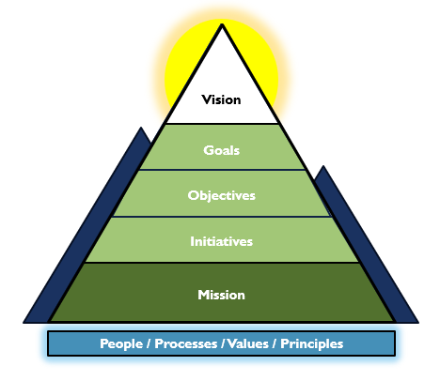
ETS PLAN FOR EXCELLENCE
GOALS
Customer Experience
  Enhance the digital experience for all users of HCA systems by delivering intuitive, accessible, and intelligent IT services.
Digital Transformation
  Leverage emerging technologies, modern development practices, and data-driven insights to deliver intelligent, high value digital solutions.
Stable Infrastructure
  Ensure system reliability, security, and adherence to regulatory requirements.
OBJECTIVES
  Enable Digital Equity …………………………….
  Optimize Workflows ……………………………
  Mature IT Service Delivery ……………………...
  Exploit Emerging Technology ……………………
  Advance Interoperability ………………………...
  Evolve Data Architecture ………………………..
  System Modernization / Scalability /Redundancy .
  Secure Access to Systems/Data …………………
  Ensure Application Performance ………………..
SFY26 INITIATIVES
  Access to Technology / Digital Literacy
  Service Request Intake / Workflow Automation / Electronic Visit Verification
  Service Level Agreements / Surveys / ITIL Service Catalog
  Artificial Intelligence
  988 / CIE / HCMACS / MPI / ECM / Prior Auth API
  GIS / BHDS / Business Rules Engine
  Benefits 24/7 / IE&E / OneWashington
  Update Policies and Procedures / Audit Compliance
  Benefits 24/7 Stabilization
  VISION: We will be a trusted partner who creates lasting value by way of our agility, service, and innovation
STRATEGY
  MISSION: We enable HCA to deliver its programs through secure, fast, and reliable technology
ETS Values:
  Innovation
  Customer Experience
  Collaboration
  Agility
  Critical Thinking Skills
ETS Guiding Principles:
  Mission Driven Technology
  Secure & Compliant by Design
  Commonality & Natural Boundaries
  Data is a Strategic Asset
  Enterprise-Wide Thinking
  Digital Equity & Accessibility
  ETS Strategy:
Our intuitive and easy to use solutions will help…
  improve access to care,
  promote health equity,
  enhance the experience of residents and providers
  Transparency & Accountability
  Human-Centered Design
  Workforce & Vendor Enablement
  Cloud-First, Where Sensible
  Agility & Continuous Improvement
  Governance & Accountability

Slide 23
Reference material

Slide 24
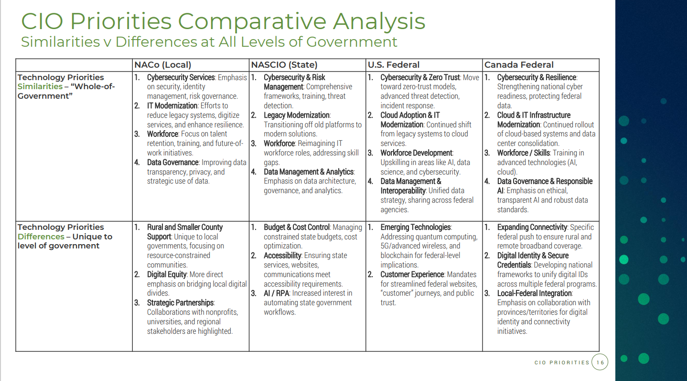
Implementing Cio Priorities in the public sector - 2025 InfoTech
①
②
③
④
⑤
⑥
⑦

